Slide 1
Student Satisfaction & Engagement Survey
Philip McGuinness, Development Consultant, sparqs

Slide 2
SSES
Context & Development
Similar Surveys (NSS, NSSE)
Implementation
Future Developments

Slide 3
Student Engagement
“students understand how they can influence their learning, and that they feel they are supported in this process” – Colleges Scotland
“students actively participating in learning in ways which help them to achieve their full potential, and playing a full part in college life, including activities like student representation” – Scottish Funding Council
“always ensure that the diversity of student voices is heard” - sparqs

Slide 4
SSES Objectives
“a national approach to monitoring student satisfaction and engagement will help to create a consistent sectoral measure and contribute to quality improvement”

Slide 5
What should a survey like this aim to do?
As students’ associations you need accurate data to be able to work effectively, and to be able to prioritise your work. If you were designing a survey like this from scratch, what would you want to find out?
Go into your groups for five minutes and have a think

Slide 6
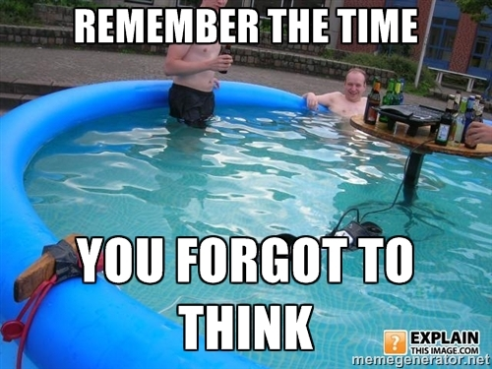
Now you’ve put some thought into it…

Slide 7
Let’s think about who else is involved

Slide 8
Group up again!
For the role you have taken on, for ten minutes we are going to try and think about what objectives they are looking to fulfil, why they need the data coming out of SSES and for what purpose

Slide 9
Students’ Associations Objectives
All Students feel part of a supportive institution
All Students are engaged in their own learning
Students work with the College in shaping the direction of learning
Develop formal mechanisms for quality and governance

Slide 10
Now we’ve thought about what the SSES is and where it’s going, how can you involve your course reps in promoting and using the survey?

Slide 11
Engaging, Training & Enabling your reps
What does this mean?
Why is this important?
How can we do it?

Slide 12
Let’s get down to nuts and bolts

Slide 13
Action Planning
What do we need to effectively promote a survey?
What do we have?
Who can help us make up what we lack?

Slide 14
Action Planning
How can we target different groups of students effectively?
How can we best equip our reps to do their jobs?
What external support is available? (hint: here we are!)

Slide 15
Ok, so you did great…
We’ve got the data that we need, how can course reps be involved in using it to the full?

Slide 16
Data Led Campaigning

Slide 17
Some examples:
Preparing for Education Scotland Reviews
Informing new course reps of ongoing issues
Focussing the college’s attention on certain areas
Learning from other SAs (in the case of question 9)
How else could your reps use the data?

Slide 18
That’s all for now!
But keep in touch because…
…sparqs want to come out and work with you and your reps when the survey comes around to make sure we get the best results we can

